Slide 1



Are there too many charities in New Zealand?
Perspectives on Charity Law, Accounting and Regulation in New Zealand – April 2018

Slide 2
Are there too many charities in New Zealand?
Per Section 3 of the Charities Act 2005:
  “to promote public trust and confidence in the charitable sector”
  “to encourage and promote the effective use of charitable resources”
Does the number of Registered Charities in New Zealand:
  Have a negative impact on public trust and confidence in the charitable sector?
  Represent the most effective use of charitable resources?

Slide 3
Registered Charities by Tier

Slide 4
Tier 4 Charities by Activity in Auckland

Slide 5
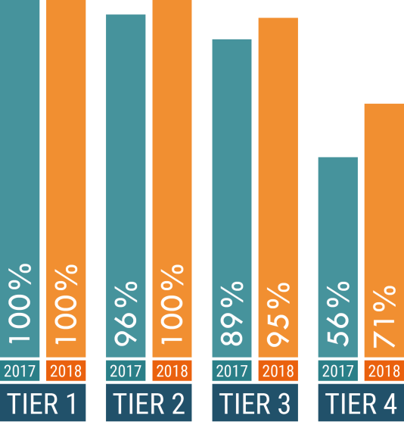
Uptake of standards 2017 - 2018

